Slide 1
Error Budgeting for Superconducting Modular Quantum Architecture Designs
APS March Meeting (2025)

Slide 2
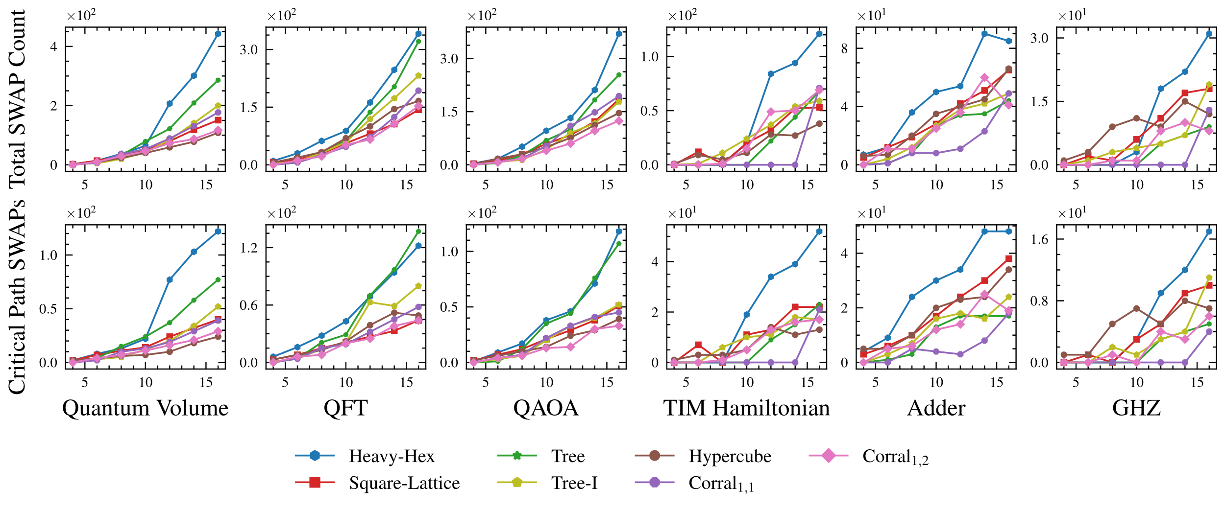
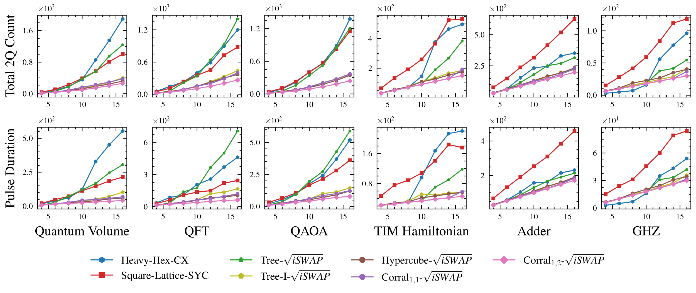
Transpilation as co-design framework
Connectivity reduces circuit costs
Quantum algorithm
Device Constraints
mode frequency bandwidth
fabrication precision
hybridization strengths
coupler speed-limit
Circuit mapping
Gate decomposition to ISA
Gate fidelity threshold
# qubits per module
qubit-coupler connectivity
Control optimization
Device execution
Qubit frequency allocation
# unique qubit frequencies
How much qubit connectivity is feasible with high fidelity?
McKinney, et al. HPCA (2023)
Notes:
Maximum vertex variants?
Maximum incident edges per node?
Maximum adjacent vertices?

Slide 3
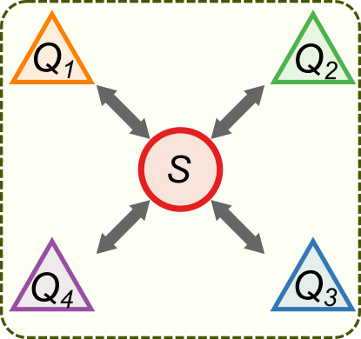
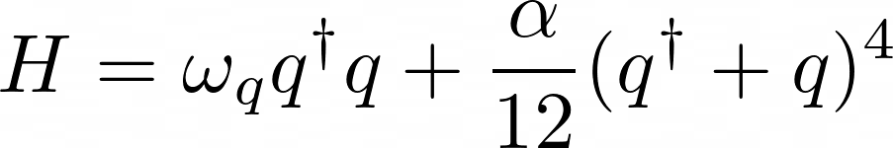
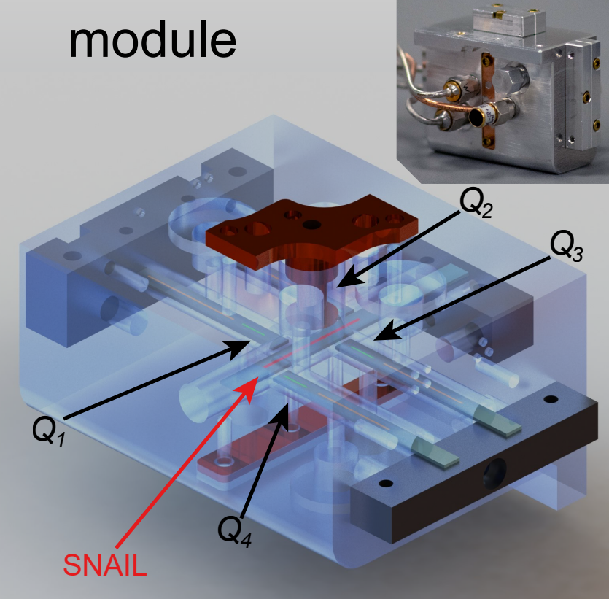
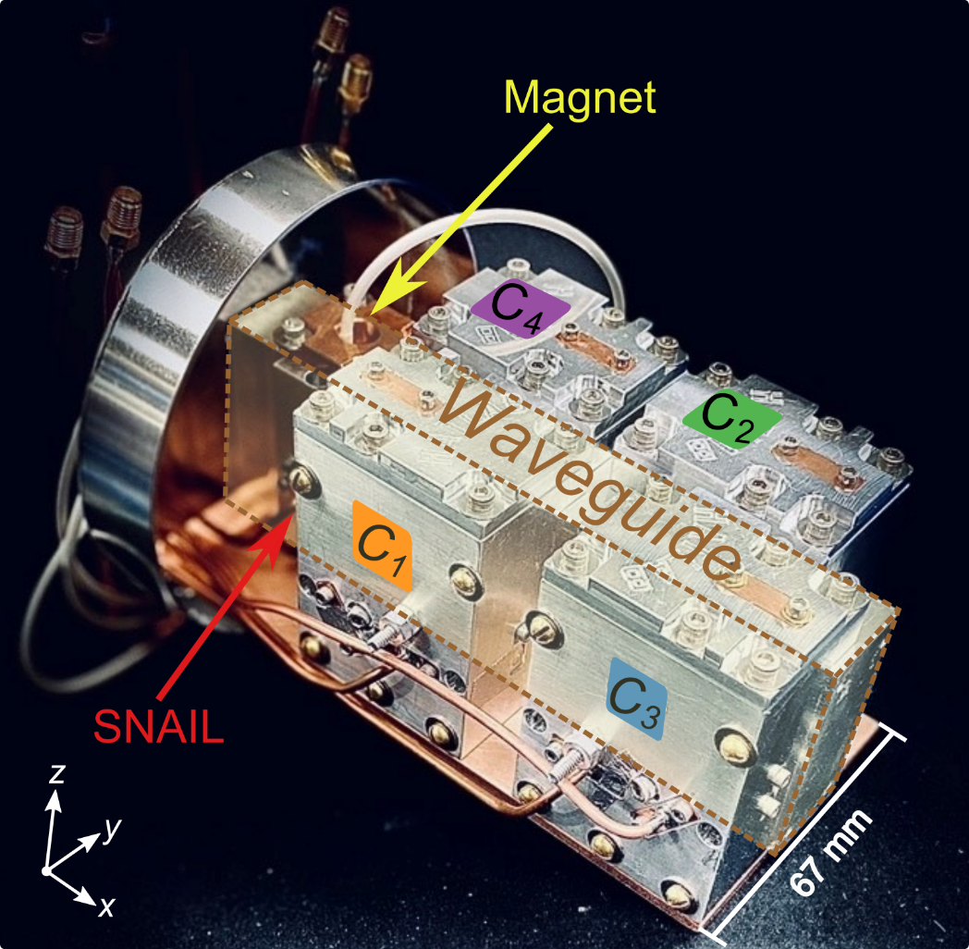
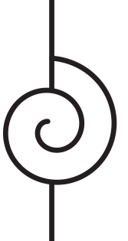
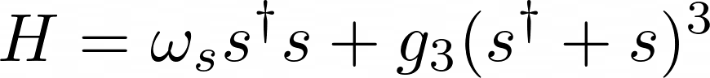
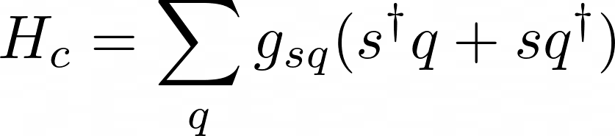
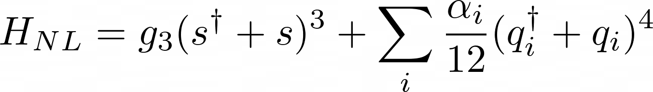
Four qubit SNAIL-based quantum module
Module:
Yusuf, MAR-A18.13
Repicky, MAR-L18.13
Transmon (qubit)
SNAIL (coupler)
SNAIL:
Wang, MAR-W09.11
Mesits, MAR-N17.3
Nowicki, MAR-T09.11
Xia, et al. arXiv:2306.10162 (2023)
Zhou, et al. npj Quantum Inf 9, 54 (2023)
Frattini, et al. Applied Physics Letters (2017)

Slide 4
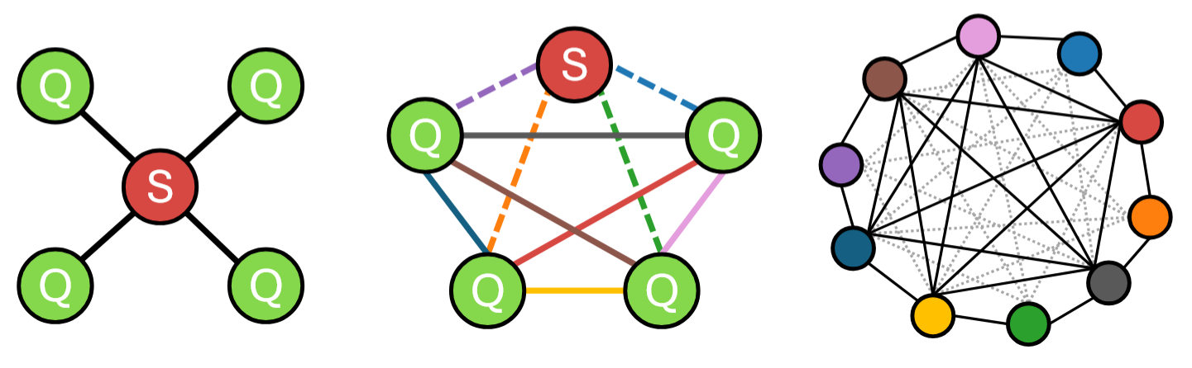
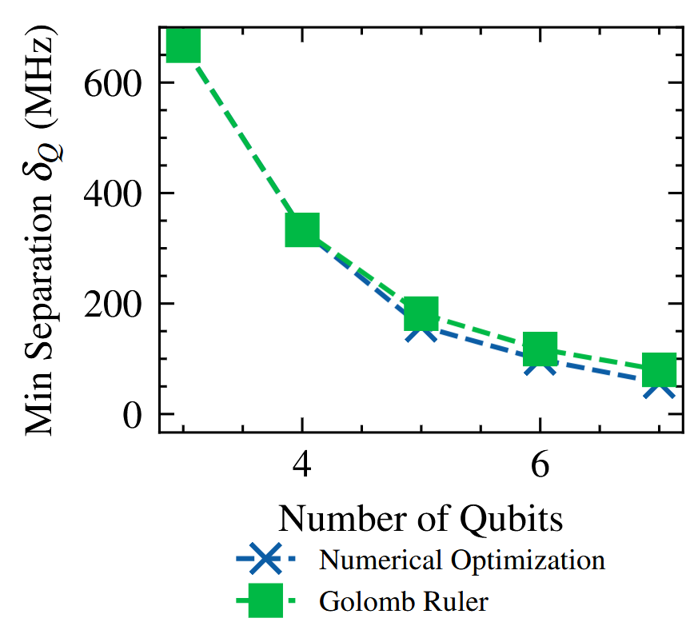
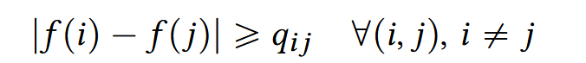
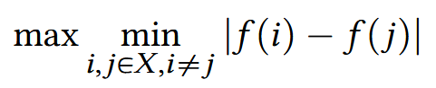
Gate crowding in a module
Pairs of driven interactions
Edge: conversion frequency
“Compatibility graph”
Edge: separation constraint (q)
Frequency Allocation Problem
de Freitas, et al. ITOR (2021)
Park, et al. J. Oper. Res. Soc. Jpn. (1996)
Memarsadeghi. CSE (2016)
Notes:
Classically, this is a linear constraint optimization problem (Frequency Allocation Problem)!
Edges in compatibility graph specify a minimum separation constraint

Slide 5
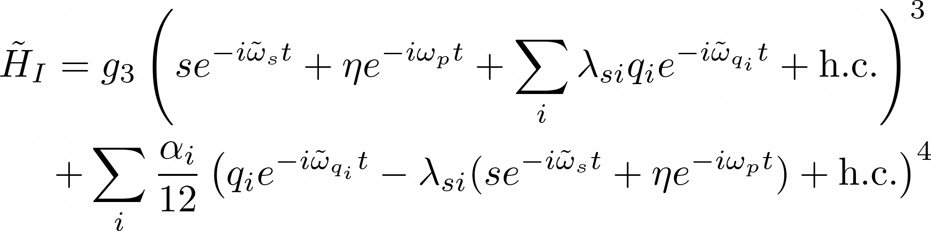
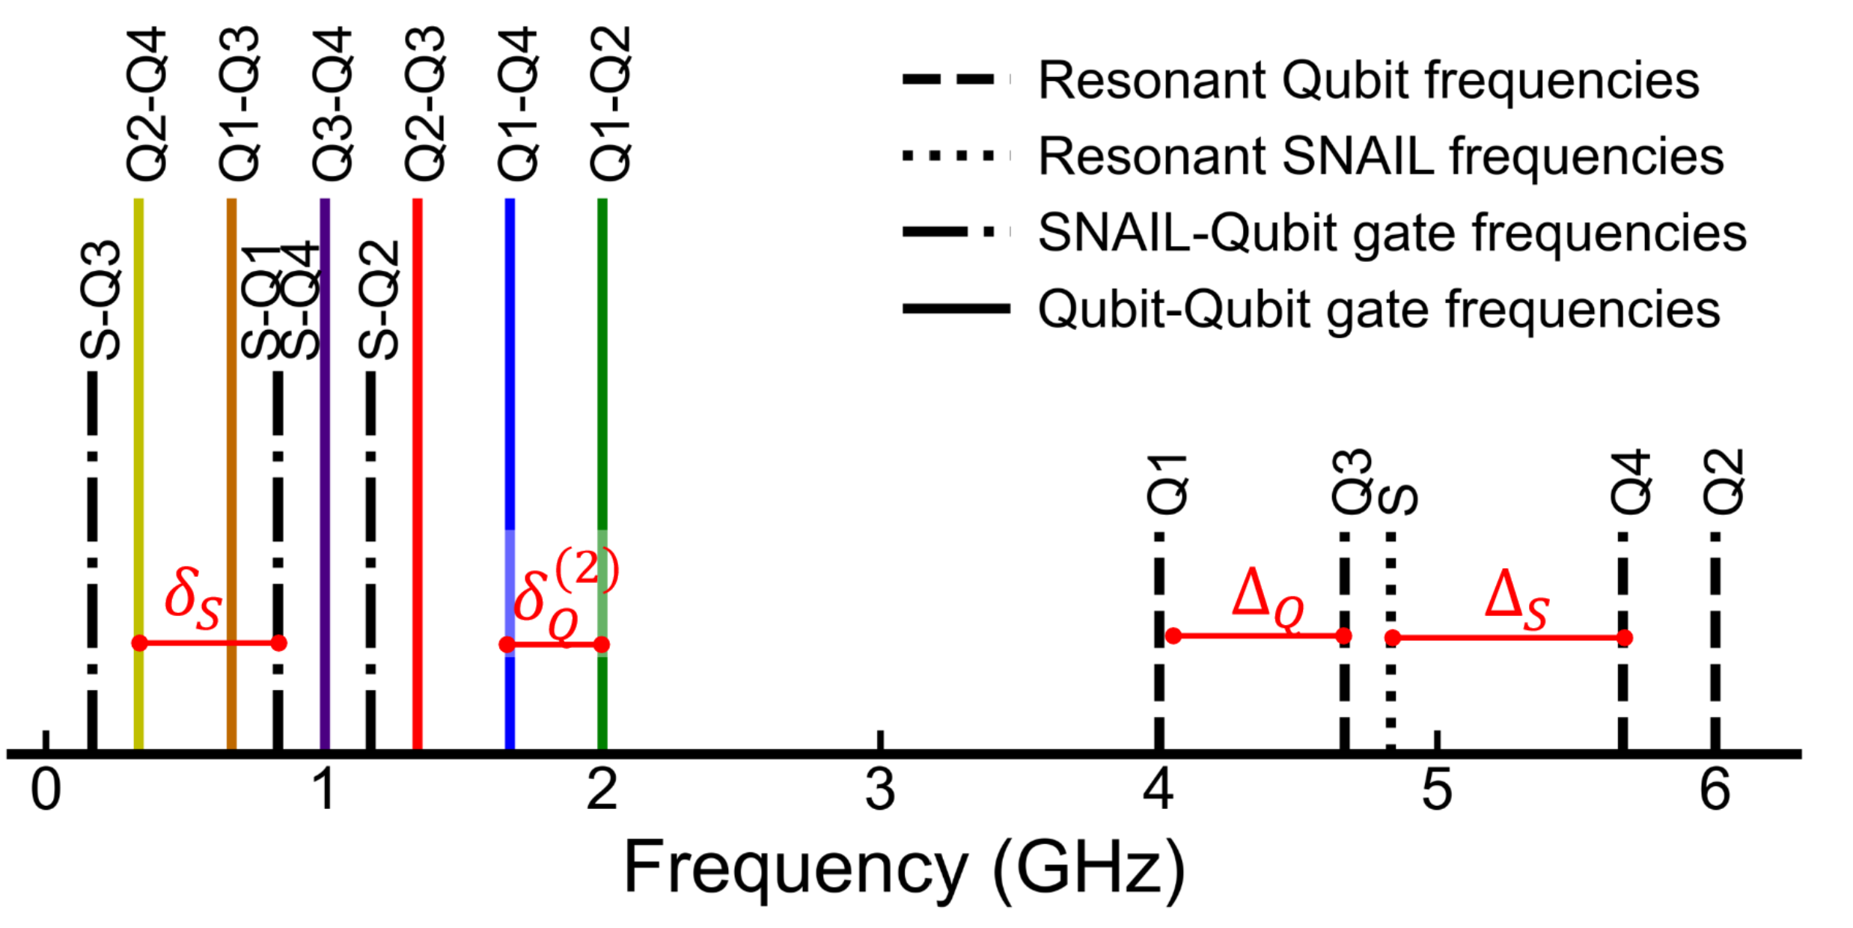
Spectral crowding of terms
Zhou, Chao. PhD Thesis (2023)
Notes:
Diagonalization, pump displacement transforms to get an interaction frame Hamiltonian.
Then we do the polynomial expansions to get full set of terms.
See that the e^-iwt terms give the pump frequencies, such that these terms go to 1 (or 0 otherwise). But when crowded, this breaks down.
Call these spectator terms, inherent crowding sources due to inadvertently activating more than the desired term due to features of the spectral allocation

Slide 6
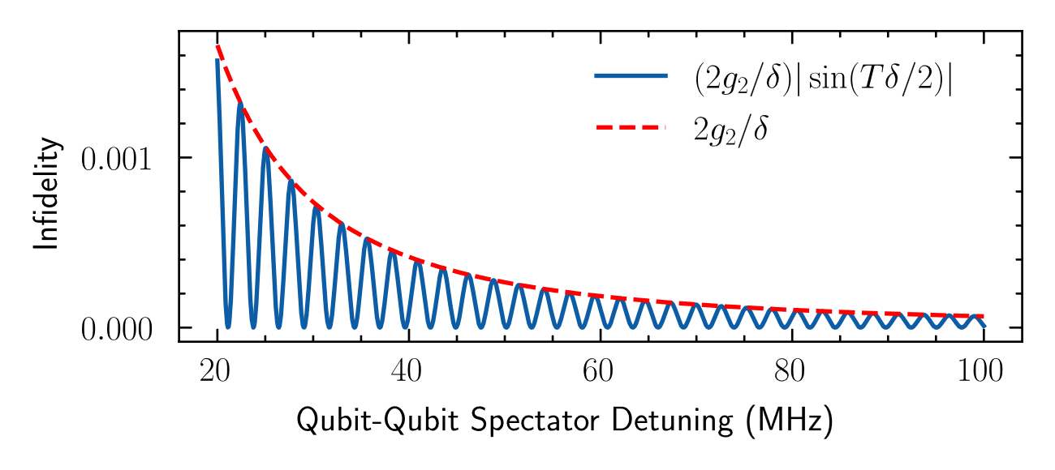
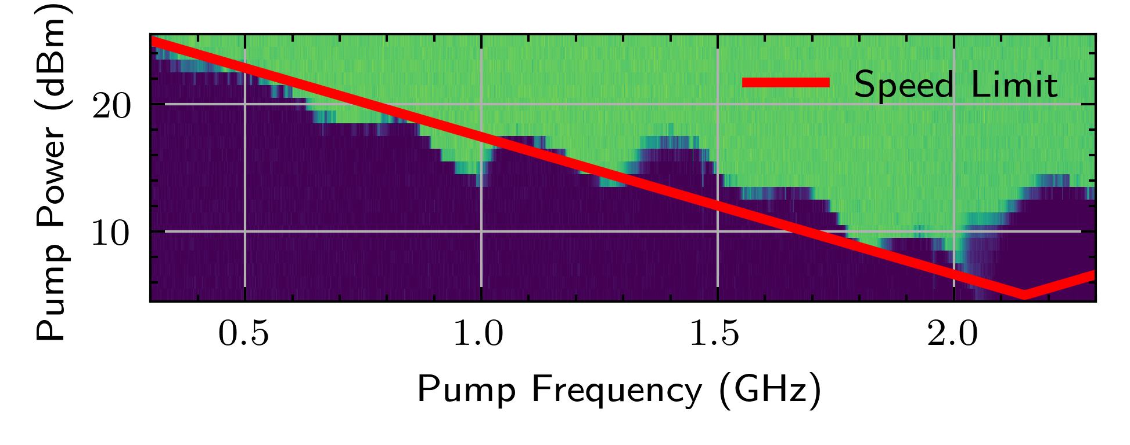
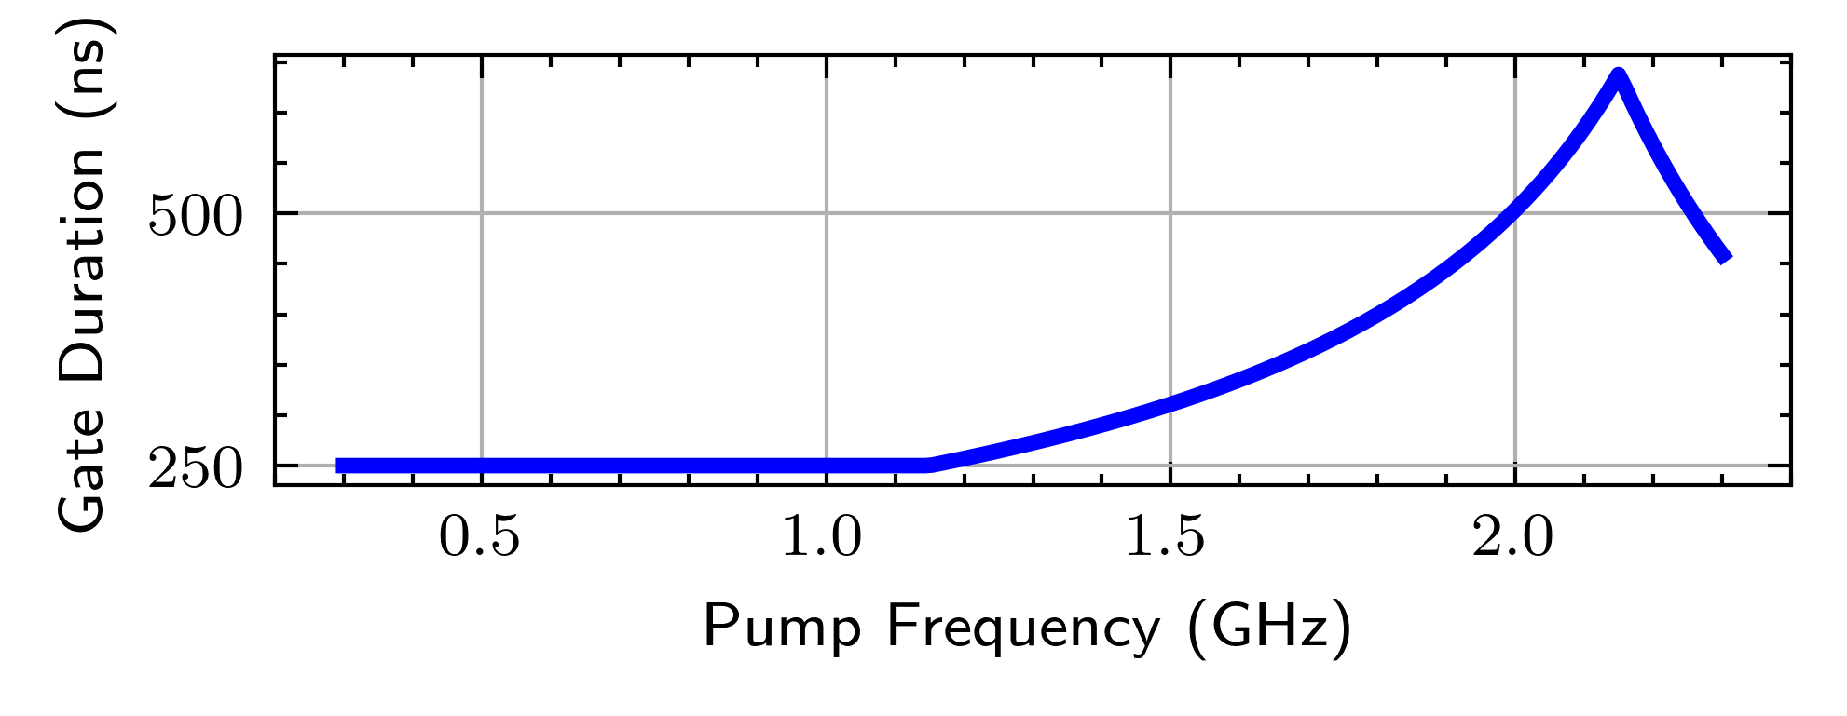
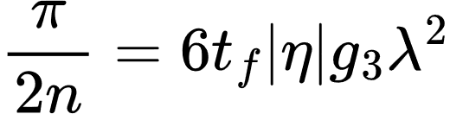
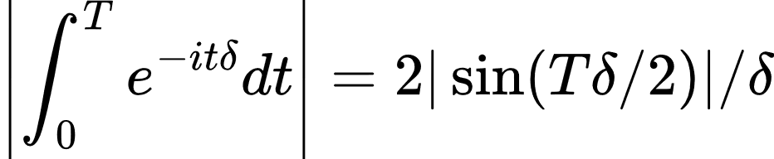
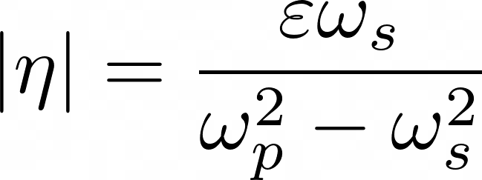
Sources of infidelity from module crowding
Coherent error from spectators
Incoherent loss from speed limits
Unwanted unitary terms decay with detuning
Experimentally characterized max drive strength
Remove explicit time-dependence with a worst-case approximation.
Parametric Speed limits: Xia, MAR-L36.2 Capocci, MAR-L36.3
Zhou, Chao. PhD Thesis (2023)
McKinney, et al. ISCA (2023)
Notes:
Plug other MM talks, Jake/Mingkang/Blais;

Slide 7
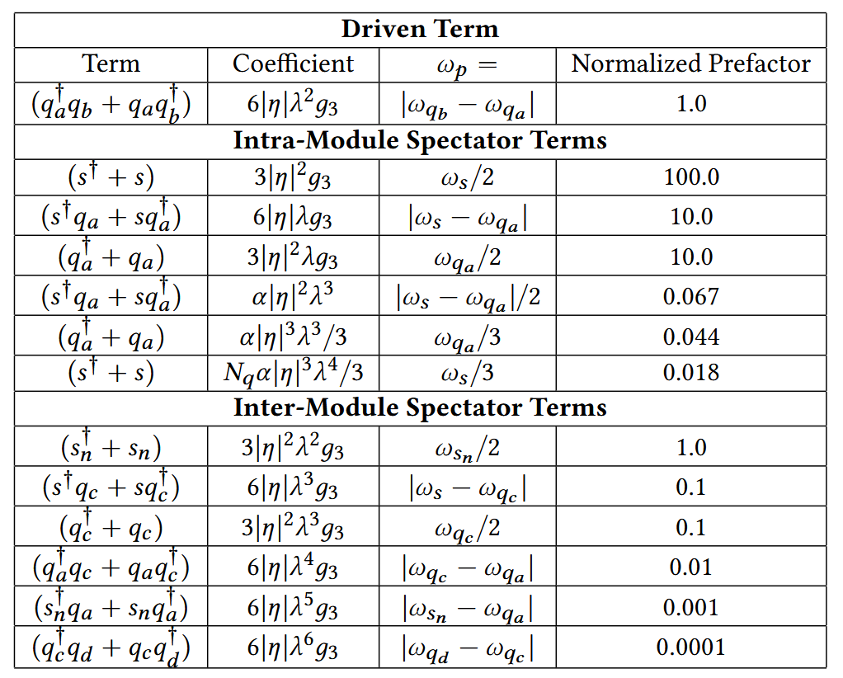
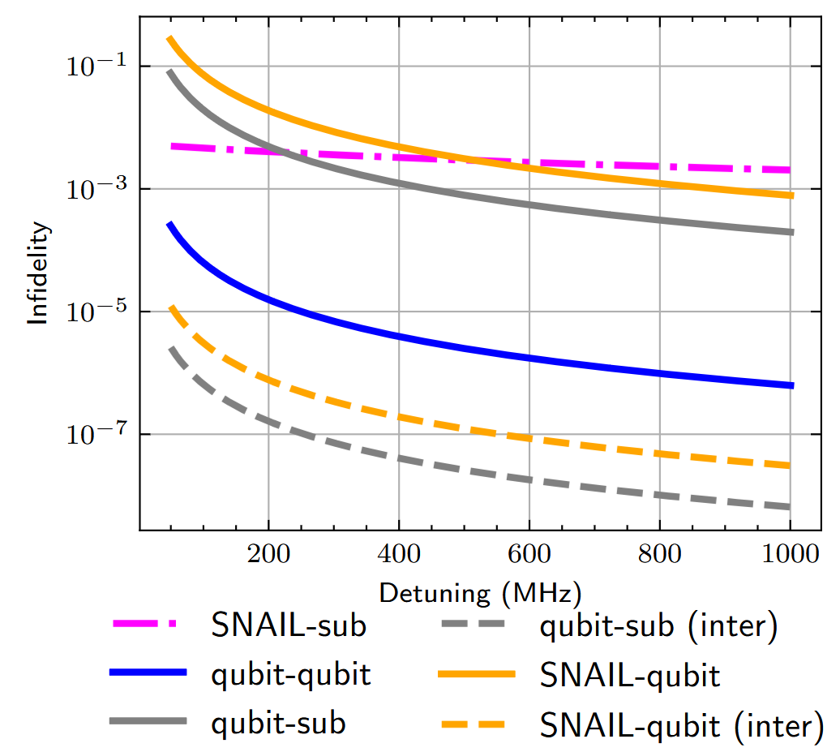
Error budgeting against spectators
For each interaction, use infidelity vs detuning characterization in Nelder-Mead minimization to allocate best mode frequencies
Notes:
Walk through graph carefully how do you get out of it, either make the gates slower or make detuning larger!!!

Slide 8
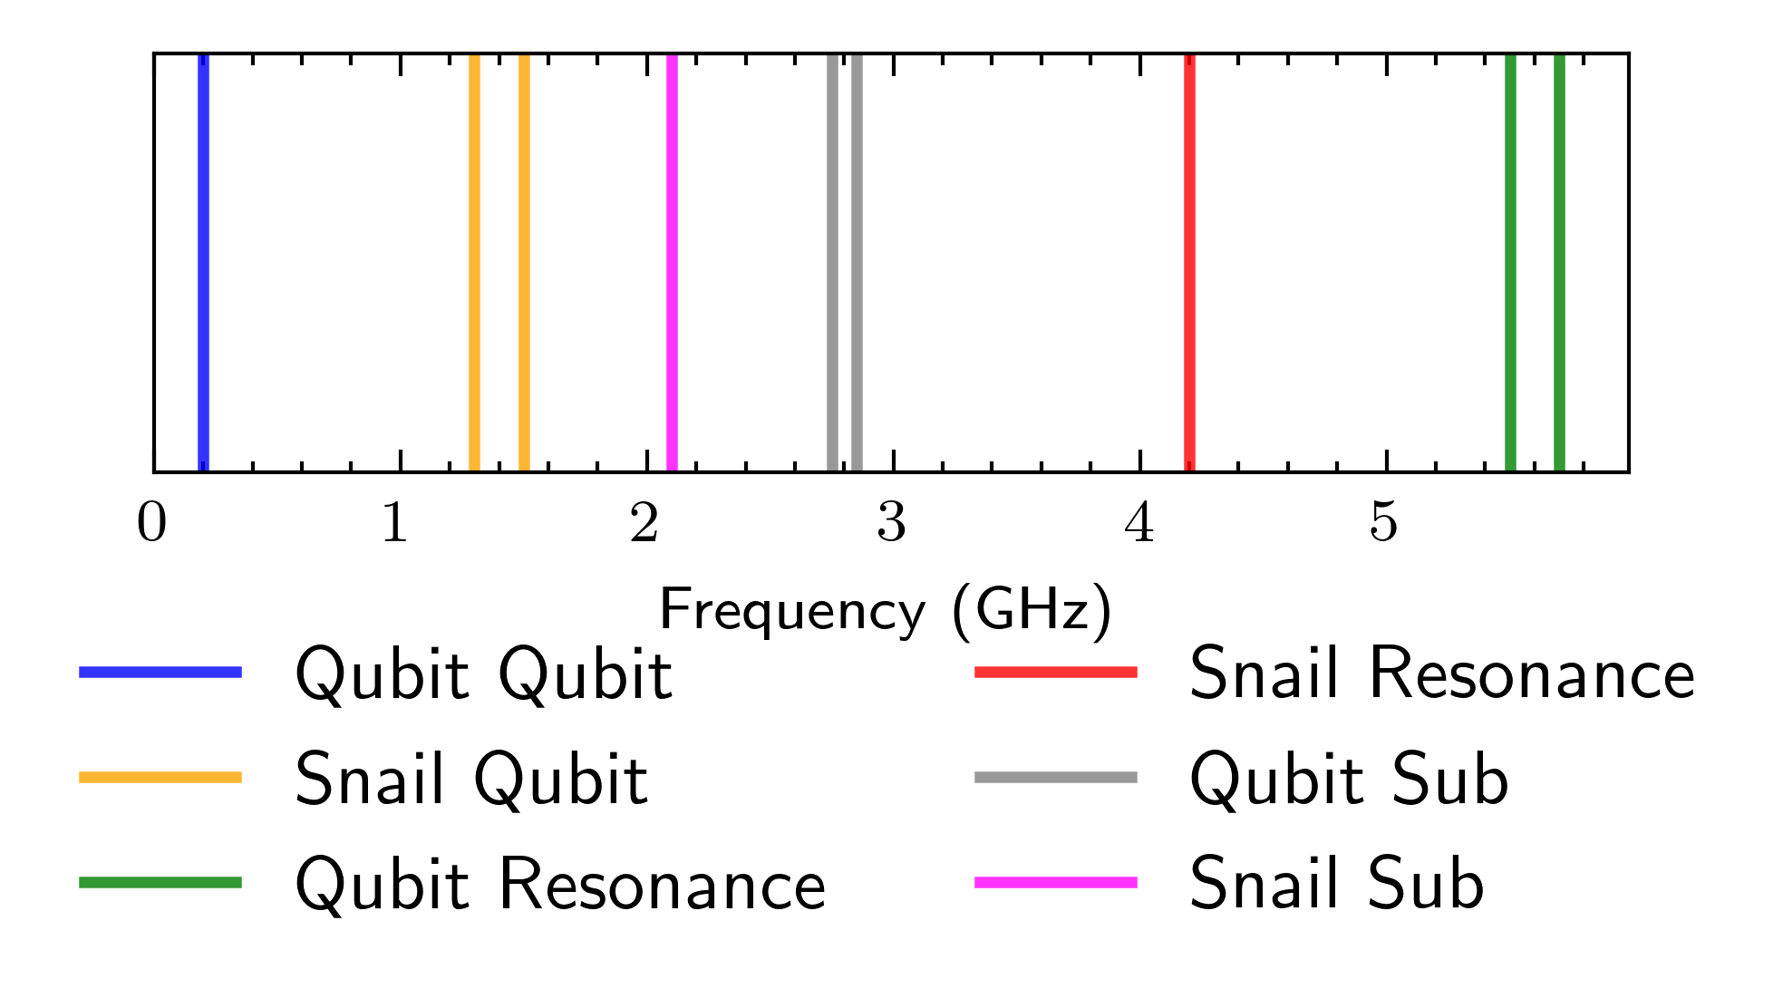
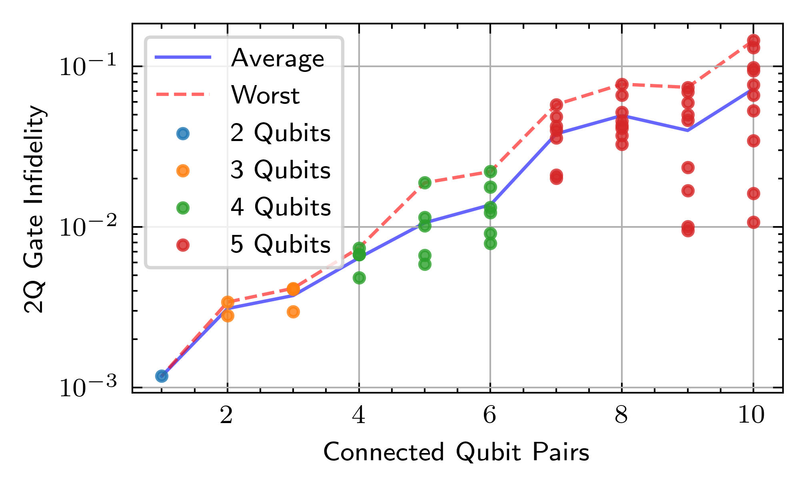
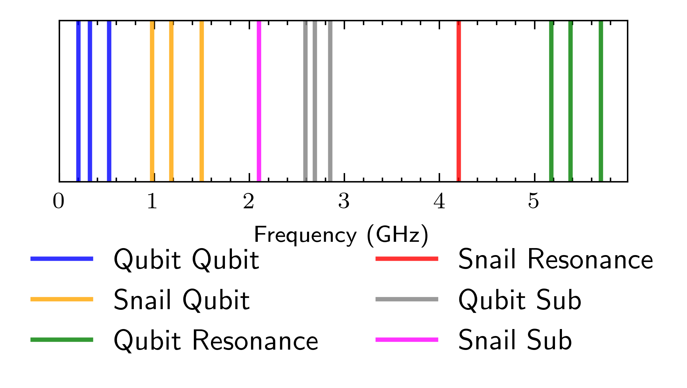
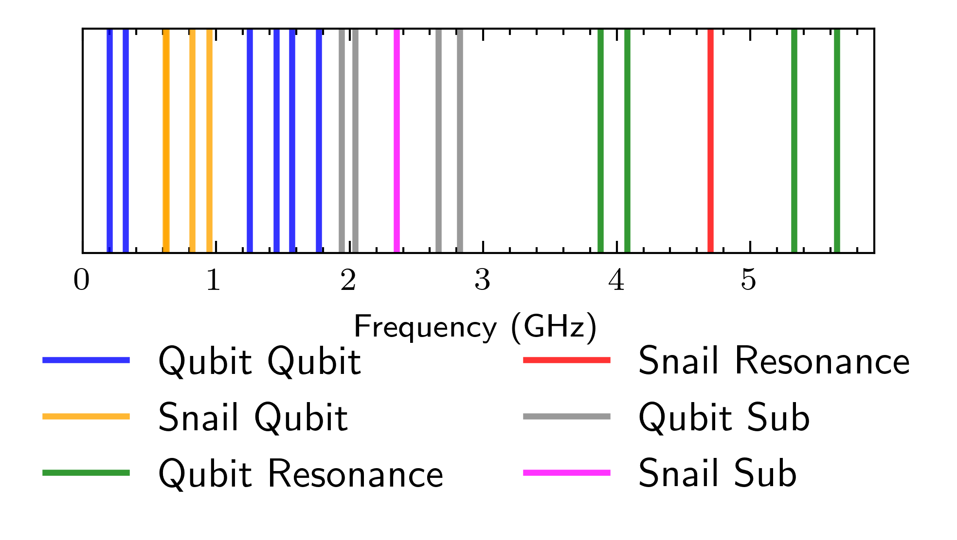
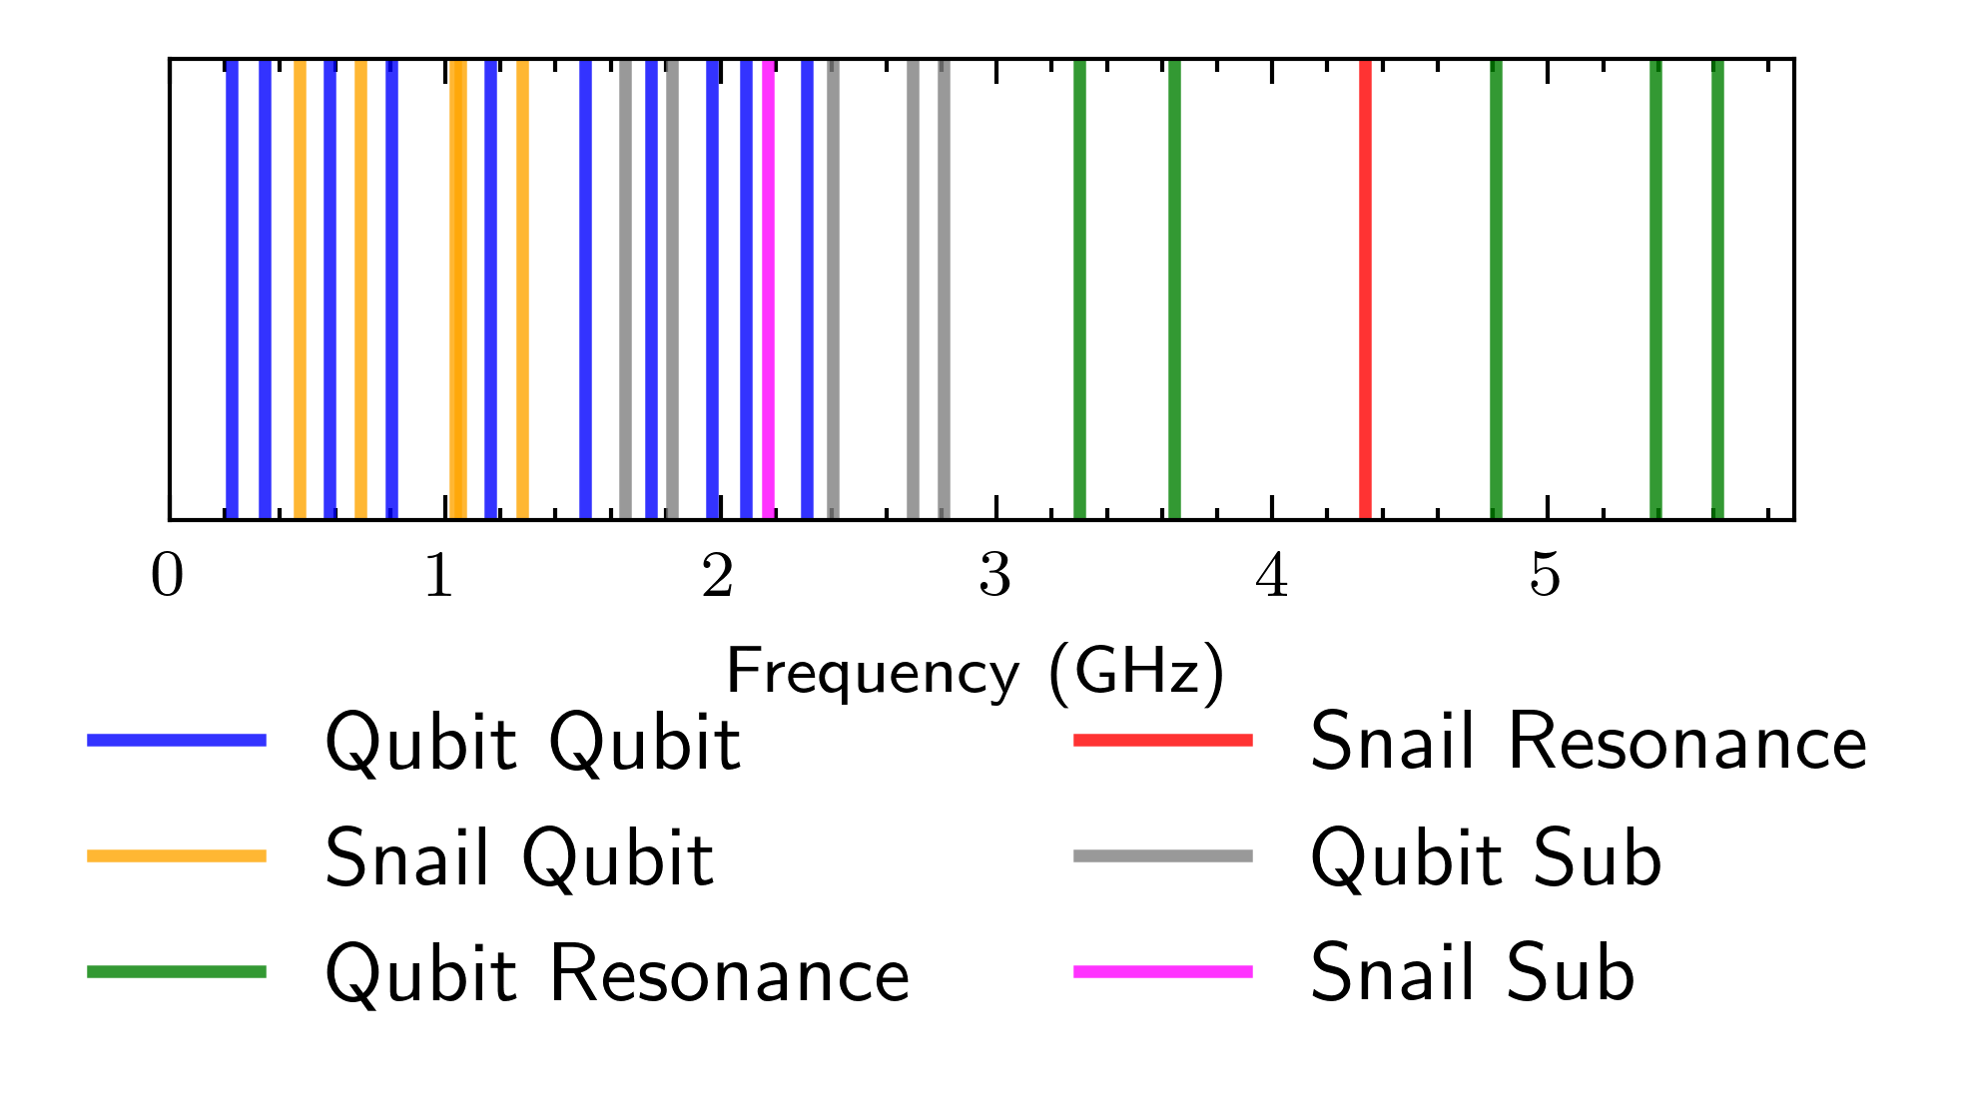
Module fidelities from optimized frequency stacks
N-qubit module | Avg gate fidelity
2 | .996
3 | .994
4 | .990
5 | .940
Notes:
Need to emphasize the key ingredients
Assume lifetime, assume speed limit – put numbers on the slide!

Slide 9
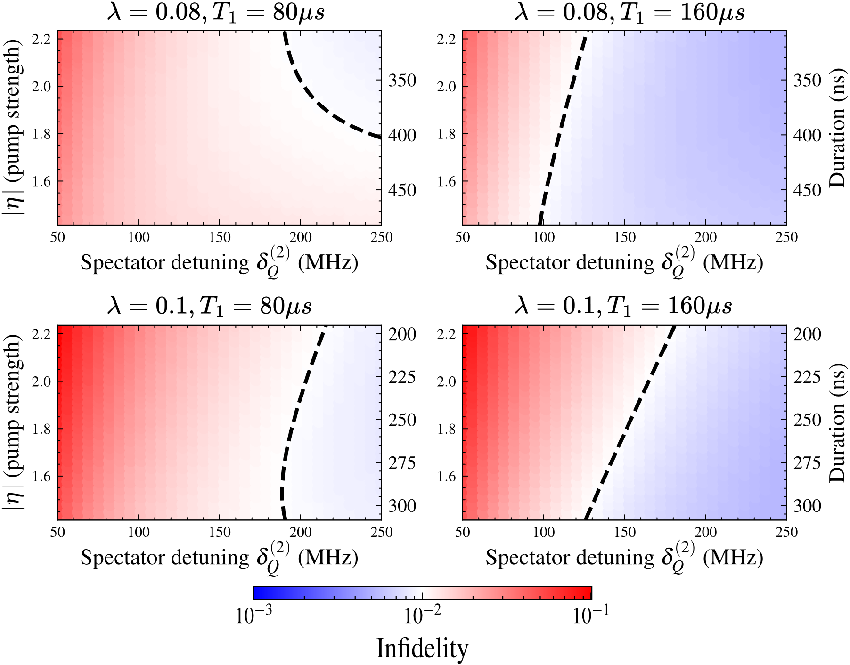
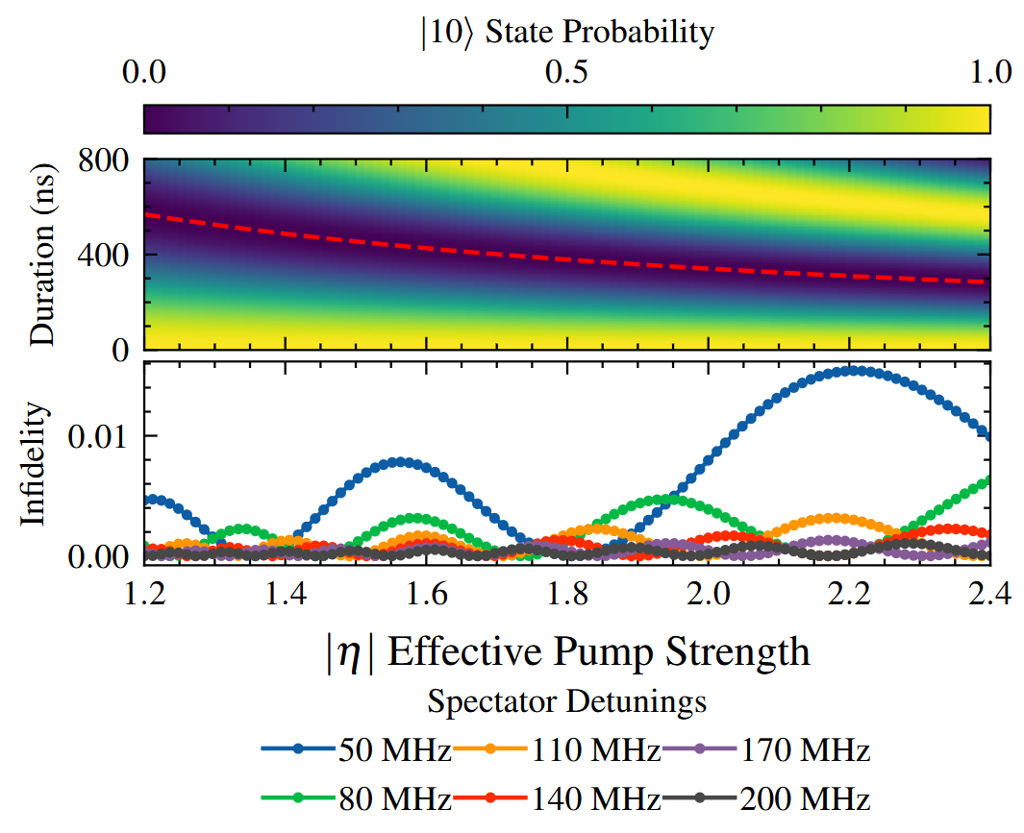
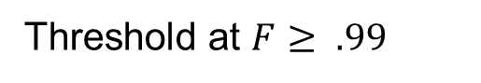
Tradeoffs between gate speed and spectators
Larger frequency bandwidth: increase spectator detunings
Longer qubit lifetimes: slower gates, weaker spectators
Threshold at $F≥ .99$
Wei, et al. Phys Rev Applied (2024)
Notes:
Assume lifetime, assume speed limit – put numbers on the slide!
Turn up the T1 by 10 and reoptimize with new spectators

Slide 10
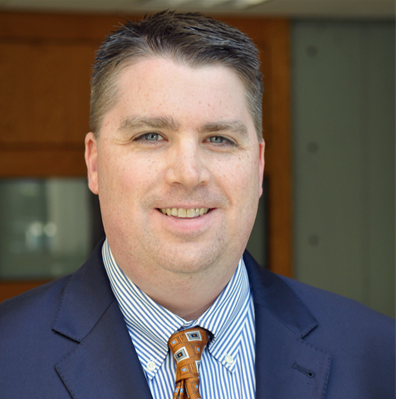
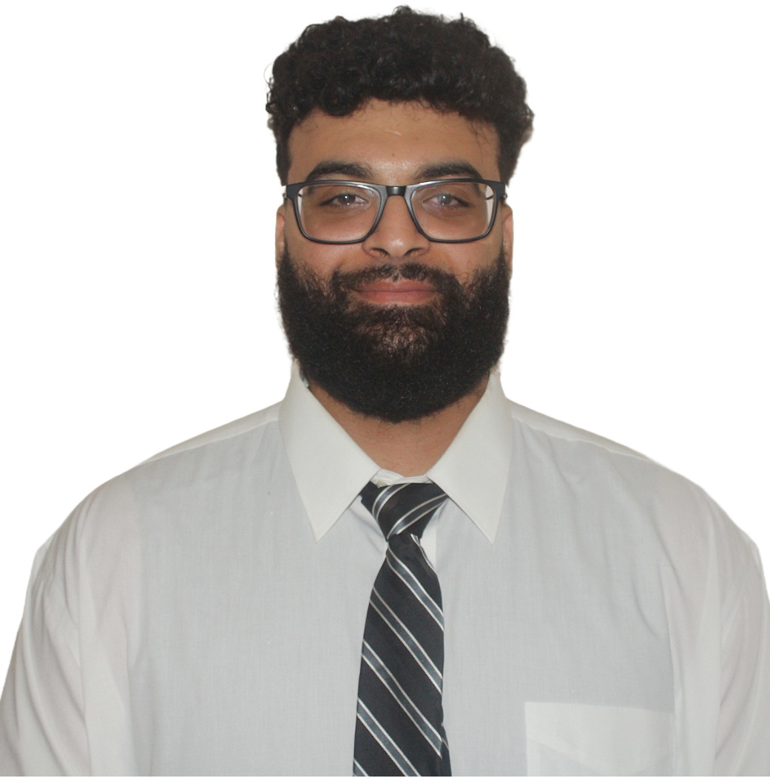
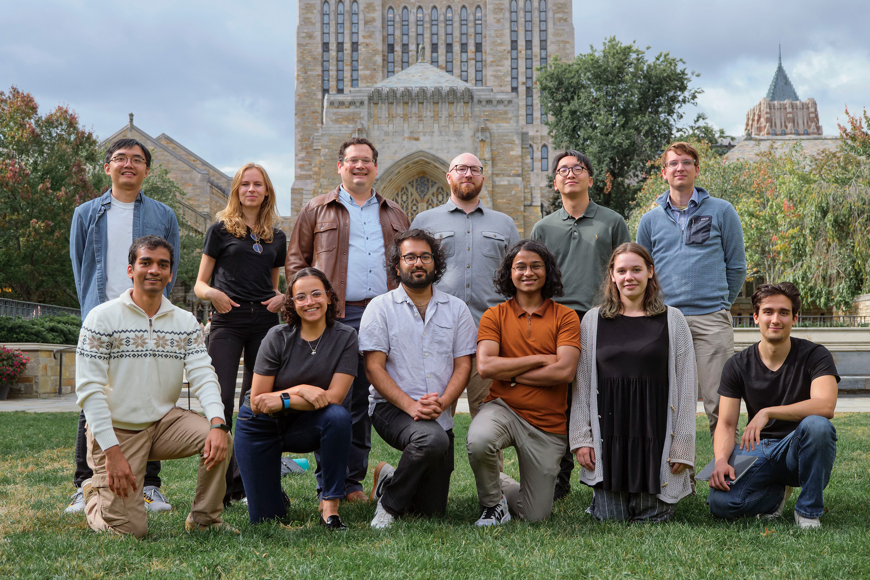
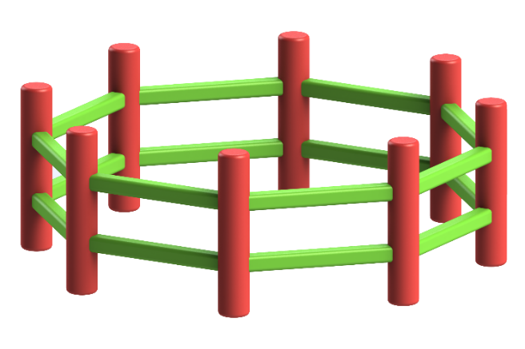
Conclusions
McKinney, et al. arXiv:2409.18262 (2024)
Developed a fidelity model from characterized device properties
Quantified tradeoffs between coherent and incoherent noise sources
Develop numerical optimization to minimize total average gate infidelity
Frequency allocation problem to determine viable module sizes
SNAIL module supports up to 4 qubits before fidelity drops below 0.99
Partial frequency allocation improves base fidelity up to 0.994, yielding a 19.9% relative improvement in computational accuracy.
Alex K. Jones
Girgis Falstin
Up next: Yusuf, MAR-A18.13
Qubit
Michael Hatridge
SNAIL
Gaurav Agarwal
Israa Yusuf

Slide 11
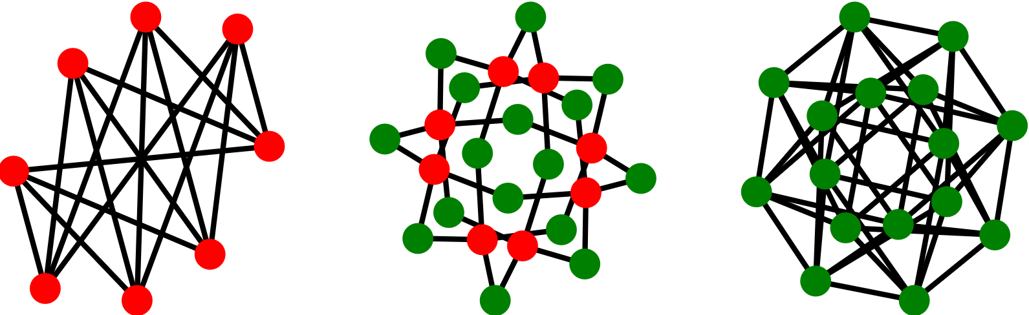
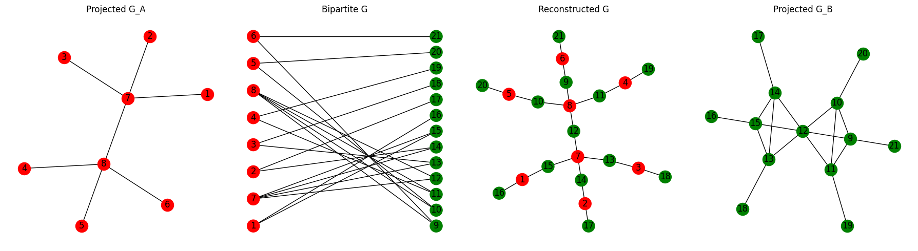
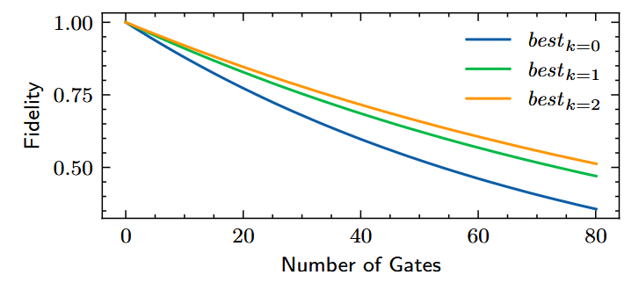
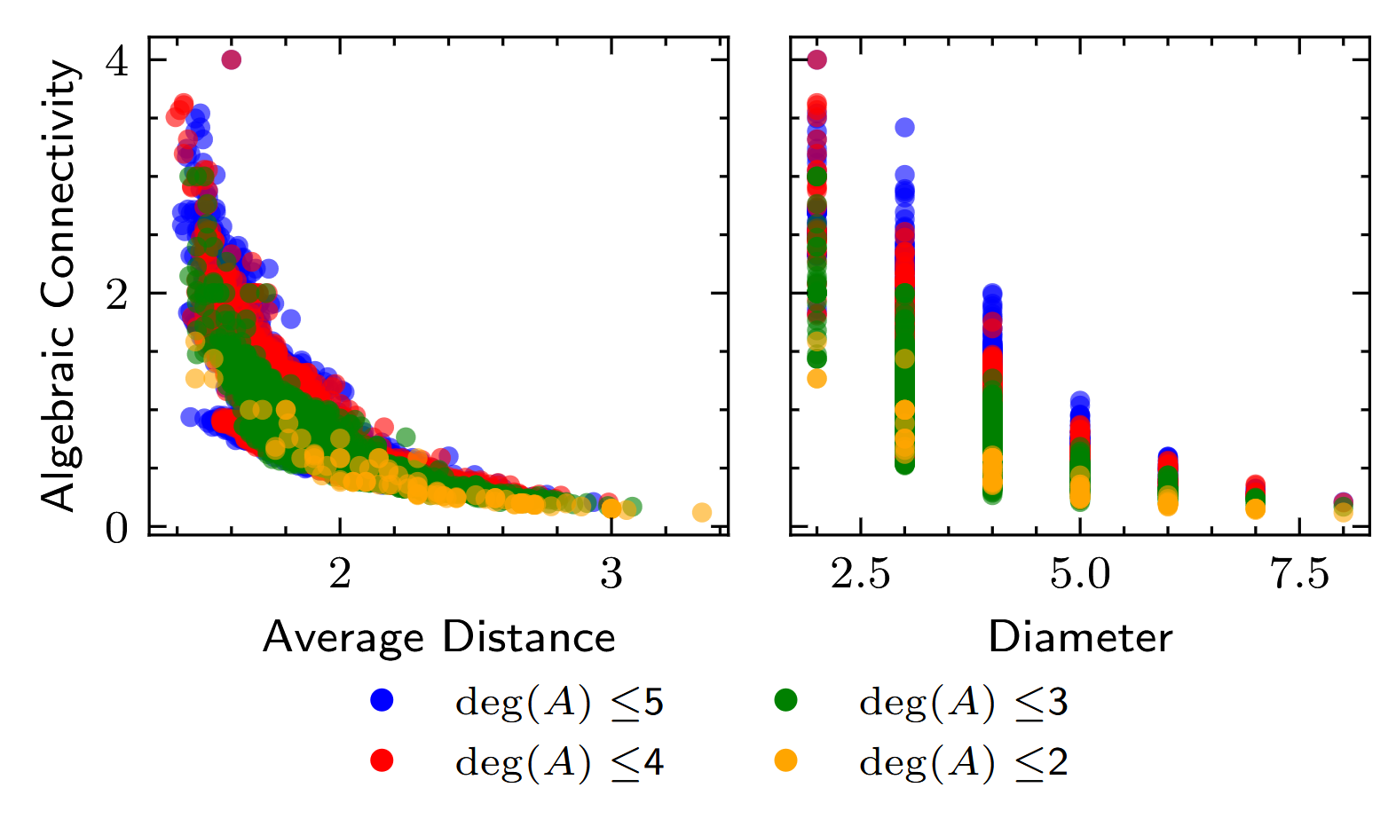
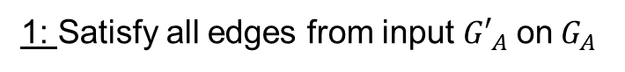
Procedurally generating topologies
Greedy inverse bipartite projection
Selective edge removal
1: Satisfy all edges from input ${G′}_{A}{ \text{on} G}_{A}$
2: Add nodes to $G_{B}$ until saturate all couplers
3: Verify isomorphism between input ${G′}_{A},$output $G_{A}$
Sacrificing dense connectivity for less spectator crowding is a worthwhile tradeoff!
Notes:
205 valid bipartite graph using 4-8 SNAILs with at least 16 qubits. (using constraint of 2-colorable module graph, max degree of snail 4, max degree of qubit 2)

